Slide 1
Cell Phones

Slide 2

In this Smart Lesson you will do the following:
Explain how cell phones transmit calls.
Describe the structures in place that help to transmit calls.

Slide 3
Modern cell phones use digital signals.
This converts your voice into a series of ones and zeros.
These signals are then transmitted as electromagnetic waves.

Slide 4
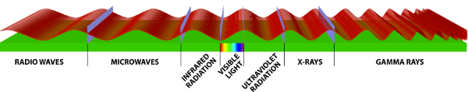
Cell networks use either radio waves or microwaves.
The frequencies are on the 'border' between radio waves and microwaves, so the type of radiation will depend on the specific frequency your cell phone uses!

Slide 5
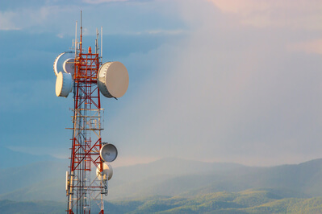
Whenever you make a phone call, the signal is transmitted to a base station.
This station can receive many messages at once.
There is one base station in every cell. A cell is a electromagnetic wave network that covers a particular area of land.
The size of the cell depends on the number of phone calls it needs to transmit. This means that cells are smaller in cities than rural areas.

Slide 6
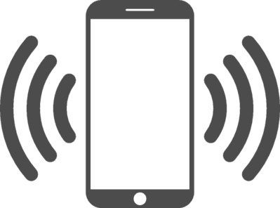
When you are in a cell, you connect to the base station in that cell.
Then, as you move away from one cell, you connect to the next base station.
When you are not in any cells, or the radio wave/microwave signal is blocked by hills, trees or buildings, you cannot make phone calls. This is because you are in a dead zone where no base stations can receive your call.

Slide 7
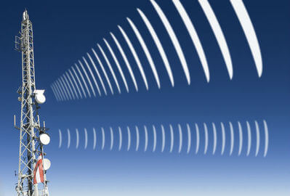
When a base station receives your call, it sends it to the base station in the cell which the person you are calling is in.
This is done via fibre-optic cables.
That base station then sends the phone call to the person you are calling as a microwave signal, or a radio signal.

